Slide 1


Slide 2
Chapter 5
The Relational Data Model and Relational Database Constraints

Slide 3
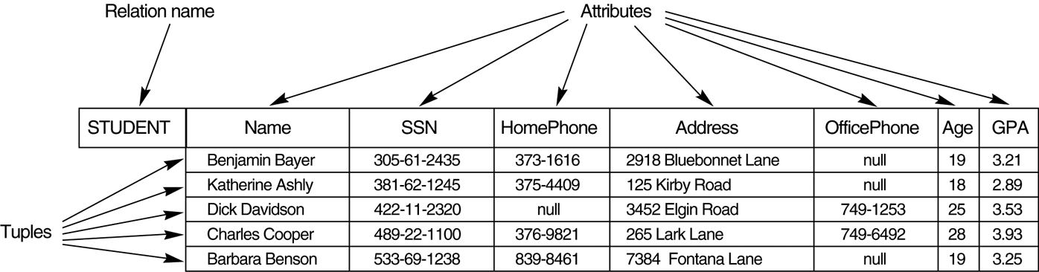
FIGURE 5.1
The attributes and tuples of a relation STUDENT.

Slide 4
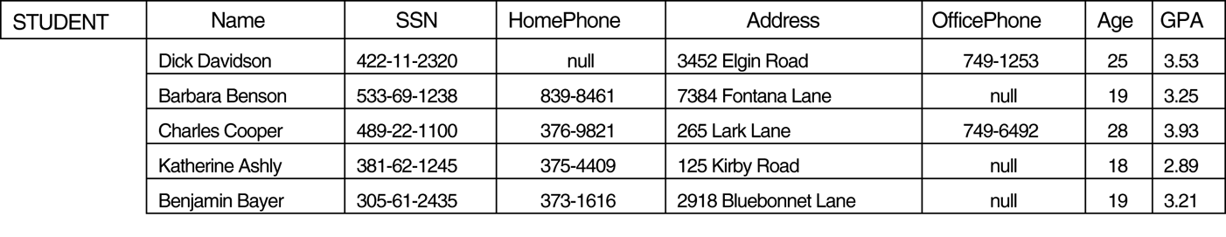
FIGURE 5.2
The relation STUDENT from Figure 5.1 with a different order of tuples.

Slide 5
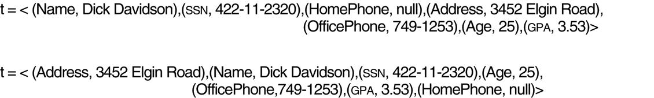
FIGURE 5.3
Two identical tuples when the order of attributes and values is not part of relation definition.

Slide 6
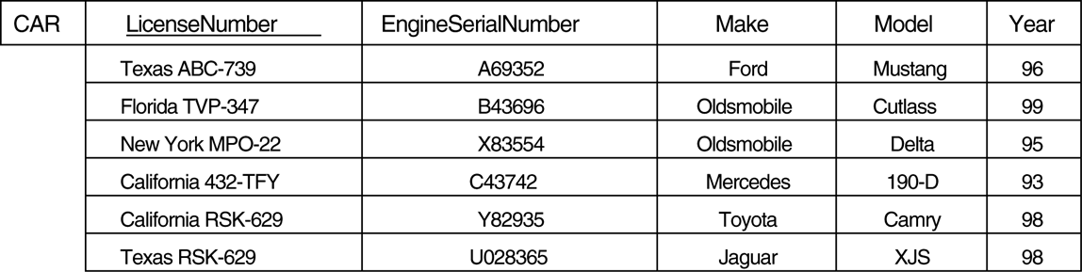
FIGURE 5.4
The CAR relation, with two candidate keys: LicenseNumber and EngineSerialNumber.

Slide 7

FIGURE 5.5
Schema diagram for the COMPANY relational database schema.

Slide 8

FIGURE 5.6
One possible database state for the COMPANY database schema.

Slide 9

FIGURE 5.7
Referential integrity contstraints displayed on the COMPANY relational database schema.

Slide 10
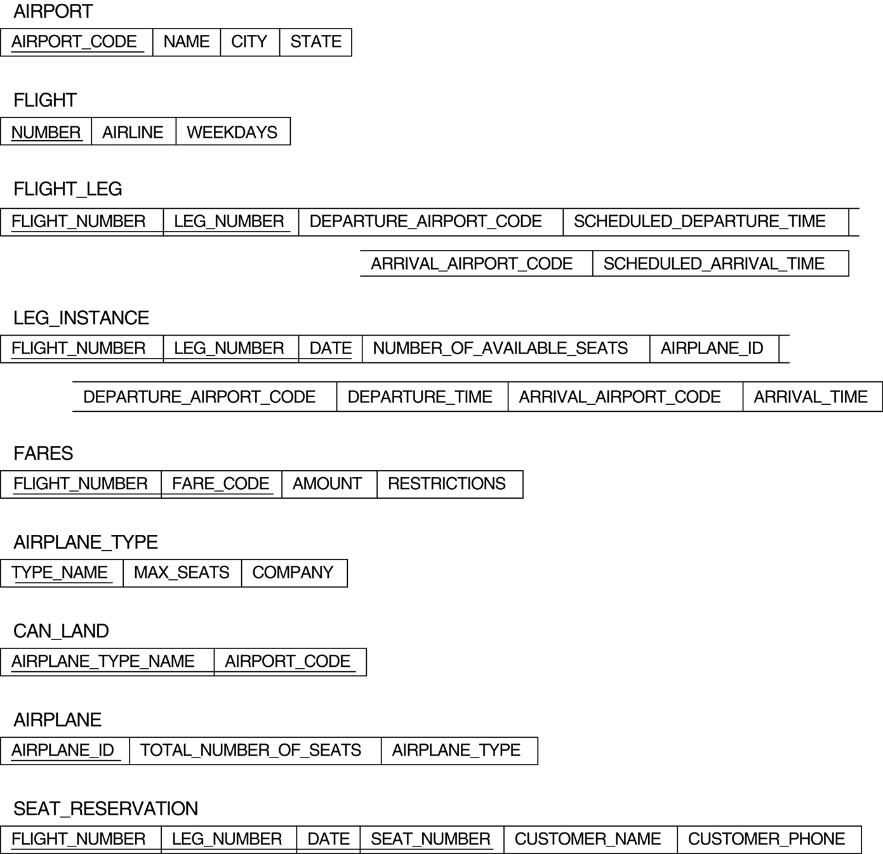
FIGURE 5.8
The AIRLINE relational database schema.

